Slide 1
StoCellAtor
A whole bacterial cell model
Peter Sarvari
PEGS 2022
Notes:
Hi everyone, my name is Peter Sarvari, and in the next 25 minutes I’ll talk about the project that started off as my Master’s thesis and is now published in the journal called Biology. Funny thing is that we submitted it to the journal exactly two years ago. StoCellAtor, a stochastic cell simulator is a whole bacterial cell model that links a detailed codon-level translation model to a stochastic version of an existing whole-cell model published by Weisse et al. Before I get into the details, let me clear up some jargon to make sure we’re all on the same page.

Slide 2
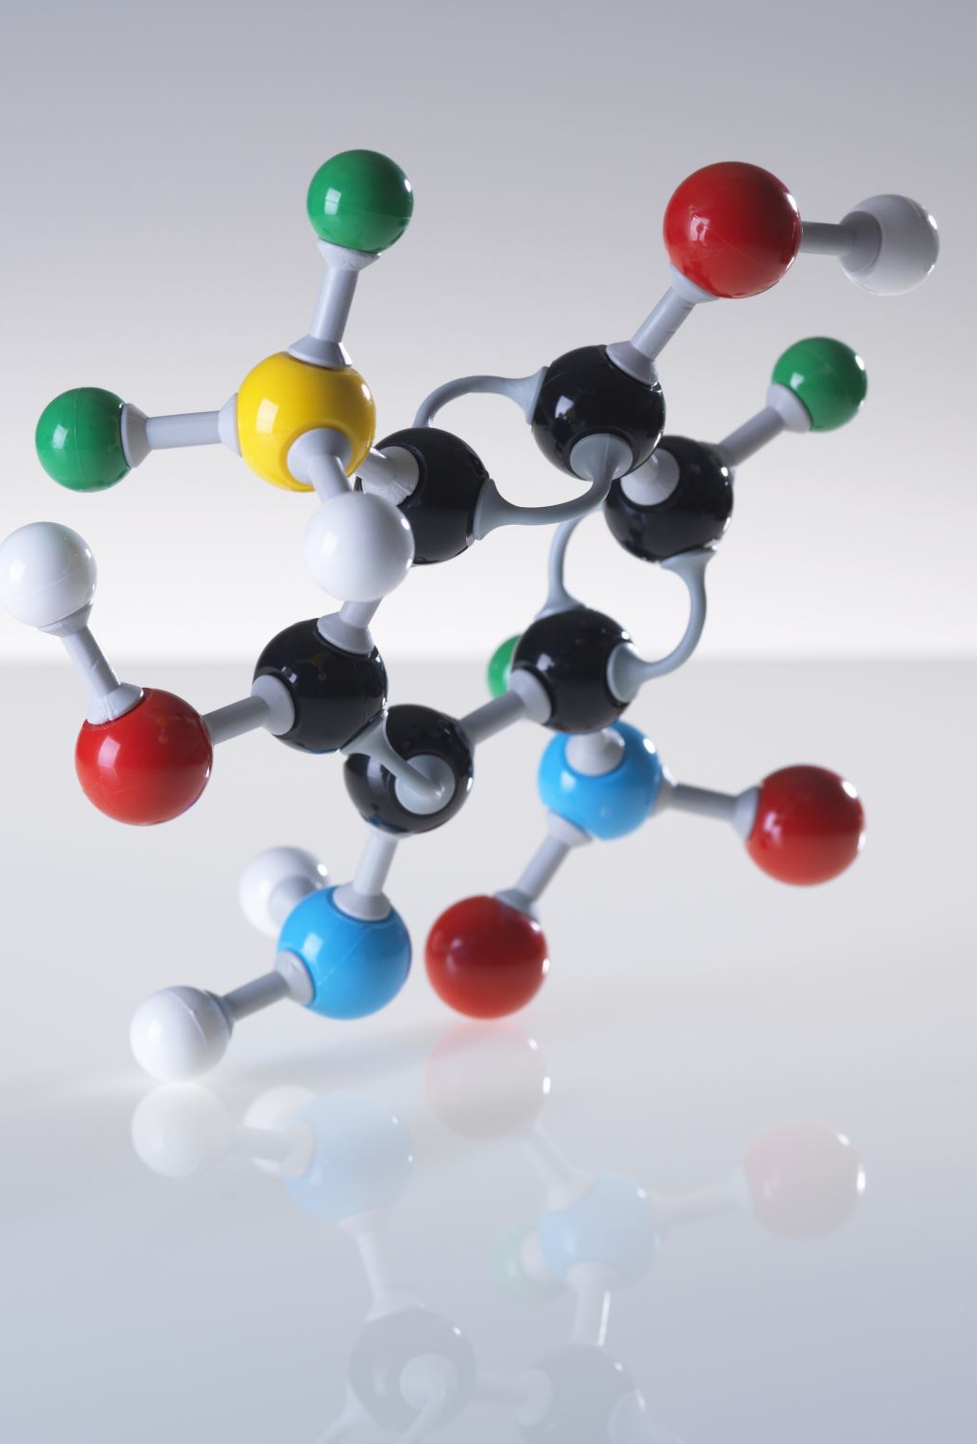
A few concepts in whole-cell modelling for synthetic biology…
Corse graining
Ribosomal (R), Enzymatic (E), Housekeeping (Q), Heterologous (H)
Steady-state
Codon optimization
Totally Asymmetric Exclusion Processes (TASEP) / Ribosome flow model (RFM)
Burden on cell
Exponential growth / turbidostat
Notes:
We will talk about…
Course graining: Rather than individually simulating all different types of genes that exist within the bacterial cell, we bundle them into groups with similar properties. We defined 4 groups, just like in the paper by Weisse: Ribosomal, Enzymatic, Housekeeping and Heterologous (not native to the cell). These 4 groups have different parameters: e.g. maximum transcription rate.
Steady-state: In the broad sense, steady-state means that the model outputs vary only negligibly by time. Once we reach steady-state, we can think of, for example, the heterologous protein production rate as a constant.
Codon optimization: Multiple codons may code for the same amino acid, but it hugely matters which codons we use in a certain organism, since the translation speed of different codon coding for the same amino acid may be different. Introducing synonymous mutations to speed up protein translation is rereferred to as codon optimization.
TASEP/RFM: These are the primary tools for codon-level translation modelling. TASEP is a computer simulation running basically the Gillespie algorithm, whereas RFM is a set of differential equations describing the dynamics of the ribosome movement on the mRNA.
Burden on cell: Introducing unnatural, heterologous genetic material to the cell causes burden on the cell because the cell’s resources, such as polymerases, ribosomes and energy will be used to express the heterologous gene. This, in turn, will reduce the cell’s growth rate.
Growth conditions: Here, we examine exponential growth and growth in a turbidostat. Whereas the former considers unlimited nutrients and cells growing exponentially, the latter considers constant cell density, i.e. constant number of cells.

Slide 3
Corse graining
Let’s define 4 types of mRNAs / proteins
Ribosomal (R)
Enzymatic (E)
Housekeeping (Q)
Heterologous (H)
They all have different parameters
E.g. maximum transcription rate for
R: 27 molecs/cell/min
E: 20 molecs/cell/min
Q: 850 molecs/cell/min
H: RBS_H * 850 molecs/cell/min
Notes:
Rather than individually simulating all different types of genes/mRNAs that exist within the bacterial cell, we bundle them into groups with similar properties. We defined 4 groups, just like in the paper by Weisse: Ribosomal, Enzymatic, Housekeeping and Heterologous (not native to the cell). These 4 groups have different parameters: e.g. maximum transcription rate, but can also have different amino acid length and transcription kinetics.
Weiße, A.Y.; Oyarzún, D.A.; Danos, V.; Swain, P.S. Mechanistic links between cellular trade-offs, gene expression, and growth. Proc. Natl. Acad. Sci. USA 2015, 112, E1038–E1047.

Slide 4
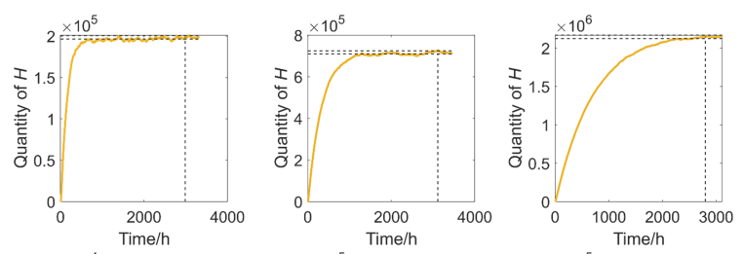
Steady-state
Dynamics are time-invariant
Now, in a stochastic model, this is not going to be strictly true as we have discrete steps, but on average, cell states, like protein production, and growth rate should not change
Inflow to an mRNA and outflow from an mRNA should be in balance
Notes:
A dynamical system is in steady-state in the broad sense, when it only changes negligibly with time. Just like in the graphs below, you see that H, the Heterologous protein production rate stabilizes after a certain time. That’s the time when the model reaches steady-state (given all other internal states have reached steady-state). We normally care about the steady-state output values in a model as the dynamics before is transient.

Slide 5
Codon optimization
There are a lot of ways to express the same protein, since the genetic code is degenerate
One can introduce synonymous mutations and speed up translation, simply because some of the codons (coding the same amino acid) are faster to translate
Depends on internal abundance of the tRNA species with the anticodon
Seems more complex than codon adaptation index (CAI), which is basically the frequency of certain codons in an organism
Welch et al found no correlation between expression and CAI
Notes:
Multiple triplets may code for the same amino acid, which gives rise to codon optimization: you still code for the same protein, but with codons that are the most efficiently translated in the host organism. The translation rate of different codons depends on the internal abundance of the tRNA species with the anticodon. There’s also a well-known proxy for translation rate of certain codons in an organism called the codon adaptation index (CAI). However, Welch et al shows no correlations between expression of certain proteins and CAI. There is a more recent adaptation index called the tRNA adaptation index, that take the internal tRNA abundances in the organism into account.
dos Reis, M., Savva, R. & Wernisch, L. Solving the riddle of codon usage preferences: a test for translational selection. Nucl. Acids Res. 32, 5036–5044 (2004).

Slide 6
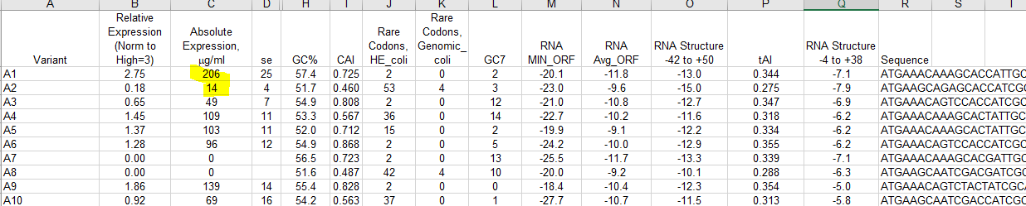
Effect of synonymous mutations
Welch et al made 40 versions of the two commercially valuable proteins, both around 900 nucleic acid long ~ 300 amino acids ~ 30 ribosome footprints; expression levels in yeast were strikingly different
From Welch M, Govindarajan S, Ness JE, Villalobos A, Gurney A, Minshull J, et al. (2009) Design Parameters to Control Synthetic Gene Expression in Escherichia coli. PLoS ONE 4(9): e7002. https://doi.org/10.1371/journal.pone.0007002
Notes:
Welch et al made 40 version of the same commercially valuable protein by introducing synonymous mutations. The screenshot from the final dataset shows how strikingly different expression levels can be: The A variants all code for the same amino acid sequence, but their absolute expression ranges from 0 to 206 ug/ml. This shows how important codon optimization is.
Welch M, Govindarajan S, Ness JE, Villalobos A, Gurney A, Minshull J, et al. (2009) Design Parameters to Control Synthetic Gene Expression in Escherichia coli. PLoS ONE 4(9): e7002. https://doi.org/10.1371/journal.pone.0007002

Slide 7
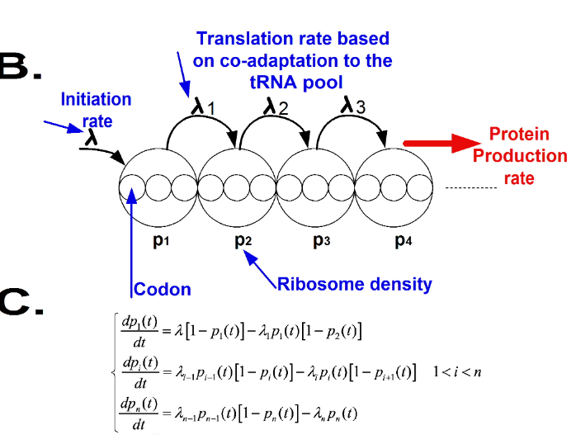
RFM
From Reuveni S, Meilijson I, Kupiec M, Ruppin E, Tuller T (2011) Genome-Scale Analysis of Translation Elongation with a Ribosome Flow Model. PLoS Comput Biol 7(9): e1002127. https://doi.org/10.1371/journal.pcbi.1002127
Notes:
Here, I will describe the Ribosome Flow Model. The governing equations are shown below. Pi is the probability that there’s a ribosome on position i on the mRNA. Lambda is the initiation rate and lambda_i is the translation rate on position i. You can observe that if the probability that ribosome site (i+1) is occupied is high, the probability of transitioning out of position i is low.
Graph from: Reuveni S, Meilijson I, Kupiec M, Ruppin E, Tuller T (2011) Genome-Scale Analysis of Translation Elongation with a Ribosome Flow Model. PLoS Comput Biol 7(9): e1002127. https://doi.org/10.1371/journal.pcbi.1002127

Slide 8
TASEP
Method to simulate the movement of ribosomes on the mRNA
Your current state is the ribosome positions along the mRNA
You can transition out of this state by one of the ribosomes moving from one codon to next
The time taken between two elongation steps is drawn from an exponential distribution with the mean being the elongation rate
The ribosome that moves is chosen randomly, proportional to its codon elongation rate
Notes:
TASEP is a way to simulate the movement of the ribosome on the mRNA. You can think of it as a Markov chain, where the current state is the ribosome positions on the mRNA and you can transition out of this state by moving one of the ribosomes on the mRNA or by initiating a new one. The next transition is chosen randomly, but proportional to initiation and codon elongation rates. The time elapsed between two transitions is drawn from an exponential distribution whose mean is the sum of all transition rates out of the current state.

Slide 9
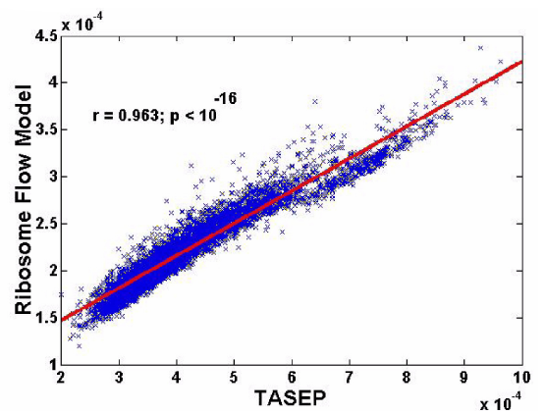
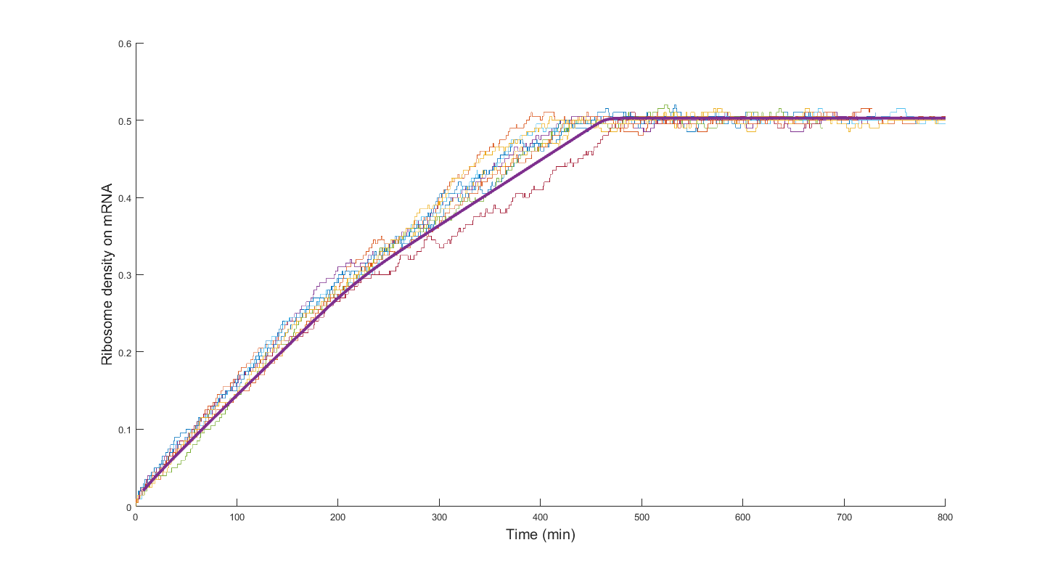
RFM vs TASEP
Takes minutes vs. takes days (depends on number of simulations)
RFM is the mean-field approximation of TASEP
From Reuveni S, Meilijson I, Kupiec M, Ruppin E, Tuller T (2011) Genome-Scale Analysis of Translation Elongation with a Ribosome Flow Model. PLoS Comput Biol 7(9): e1002127. https://doi.org/10.1371/journal.pcbi.1002127
Notes:
Right image taken from Reuveni et al. These graph illustrate that the RFM (red line) is the mean-field approximation of TASEP (blue crosses). RFM takes minutes to compute, whereas to get a long enough / plenty enough TASEP simulations to infer the steady-state expected values can take days.
It is shown in Algar et al that if we mean-field approximate TASEP, we can RFM.
R. J. R. Algar, T. Ellis and G. . -B. Stan, "Modelling essential interactions between synthetic genes and their chassis cell," 53rd IEEE Conference on Decision and Control, 2014, pp. 5437-5444, doi: 10.1109/CDC.2014.7040239.

Slide 10

Burden on the cell
The synthetic protein produced by the cell causes burden on the cell
The cell will allocate its resources to produce the heterologous protein. It’ll have to share its
Ribosomes
Energy
Amino acids
Polymerases, etc.
This will in turn slow down the growth of the cell
Notes:
Now let’s talk about how synthetic gene expression causes burden on the cell. Transcription of translation of the heterologous genetic material will divert some of the cell’s resources from contributing to the cell’s own benefit to contribute to the production of synthetic proteins. This causes a negative feedback, as the more materials are diverted from the cell, the less of these materials will be produced and hence now a smaller amount needs to be shared between the host cell and the unnatural gene’s expression. Examples of resources to be shared are… The most important consequence of the burden in terms of unnatural protein yield is the decreased growth rate of the cell – we will talk about this a lot later.

Slide 11
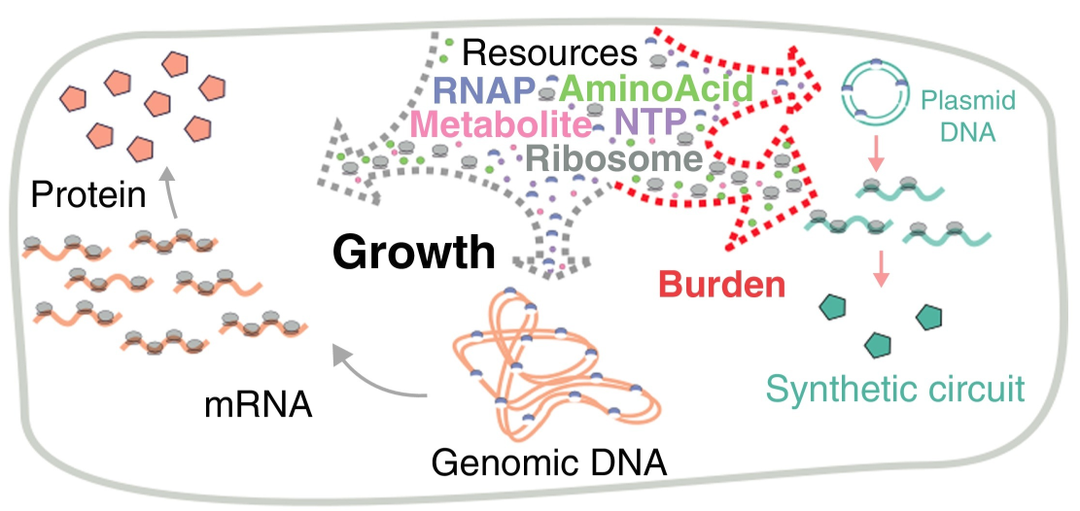
Burden reduces growth rate (Figure from Borkowski et al., Curr. Op. Mic. 2016)
From Borkowski O, Ceroni F, Stan GB, Ellis T. Overloaded and stressed: whole-cell considerations for bacterial synthetic biology. Curr Opin Microbiol. 2016 Oct;33:123-130. doi: 10.1016/j.mib.2016.07.009. Epub 2016 Aug 2. PMID: 27494248
Notes:
A visual illustration of burden on the cell from Borkowski O, Ceroni F, Stan GB, Ellis T. Overloaded and stressed: whole-cell considerations for bacterial synthetic biology. Curr Opin Microbiol. 2016 Oct;33:123-130. doi: 10.1016/j.mib.2016.07.009. Epub 2016 Aug 2. PMID: 27494248.

Slide 12
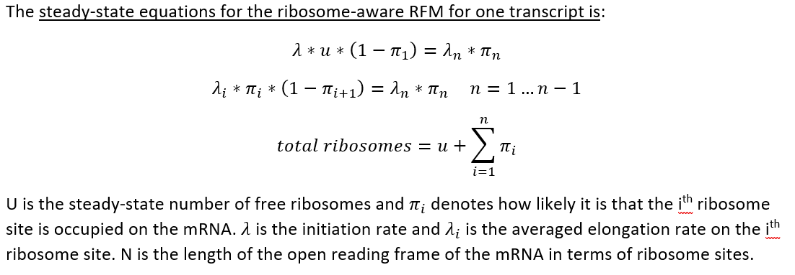
RFM with ribosome pool
Starting to become resource-aware
Has analytical solution for steady-state case
Notes:
There’s an obvious problem with the RFM I showed you previously. It doesn’t consider the dependence of the initiation on the number of free ribosomes.
There is a resource-aware RFM, where we model the existence of a finite ribosome pool. The steady-state equations for that model are shown below. As before, lambda is the initiation rate and lambda_i are the elongation rates. U is the steady-state expected number of free ribosomes and Pi_i denotes how likely it is that the i_th ribosome site is occupied on the mRNA. These equations are intuitive and actually have an analytical solution, which is shown in Reuveni et al.

Slide 13
So why we need TASEP?
It’s not clear how to use RFM is we want to model other processes in the cell
We need one RFM per mRNA, but the number of mRNAs are changing (transcription, degradation)
It’s straightforward to extend TASEP to a whole-cell setting
The time between two state transitions is taken from an exponential distribution with the mean being the sum of the rates of all possible transitions out of the current state.
These transitions now include
Nutrient transport, metabolism
Transcription, degradation, etc.
Notes:
Since RFM is a lot more efficient than TASEP it begs the question why we’re using TASEP in StoCellAtor. The truth is it’s not super clear how we can make still use RFM when we want to model other processes in the cell. As you know we have one RFM per mRNA, we can write multiple ones for multiple mRNAs, but what do we do if the number of mRNAs changes with time due to transcription or degradation?
On the contrary, it is straightforward to extend TASEP to a whole-cell setting we just have to introduce new transitions apart from initiation and ribosome movement and define the rates of these new transitions, which include nutrient transport, metabolism, transcription, degradation, etc.

Slide 14
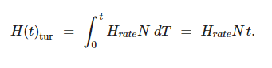
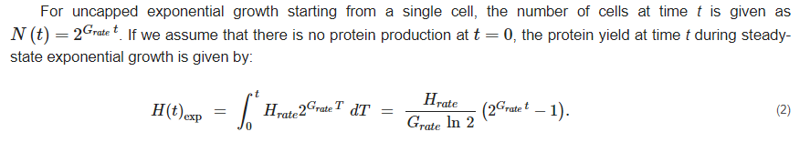
Turbidostat and exponential growth
In a turbidostat, the number of cells (N) is constant, hence the final number of proteins is just N multiplied by the production rate
In exponential growth, the number of heterologous proteins produced is determined by the following formula
Notes:
In a turbidostat, the heterologous protein yield is only dependent on the heterologous protein production rate. The number of proteins produced by time t, is just the rate per cell times the number of cells times t.
In exponential growth, the heterologous protein yield is also dependent on the cell’s growth rate. The number of proteins produced by time t can be computed using the formula at the bottom. We can get the heterologous production rate and growth rate from StoCellAtor.

Slide 15
If we had a model
Inputs
Nutrient quality
If we’re producing a synthetic / heterologous protein (not native to cell)
Codon sequence or at least relative elongation rates and mRNA length
Promoter strength
RBS strength
Output
Growth rate
Proteome / transcriptome partition
Heterologous case
Protein production rate / total production
Notes:
If we had a whole-cell model to model synthetic gene expression, there are a few obvious things to input. In turn, we expect the model to provide us with the state of the cell, the most important outputs being the growth rate, the proteome partition and the heterologous production rate.

Slide 16
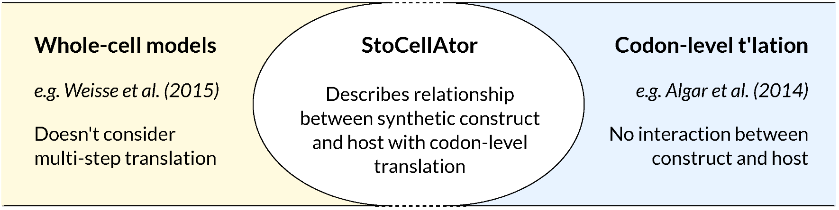
What’s the novelty in StoCellAtor
Notes:
To break StoCellAtor down further, we show that it really is a combination of two existing models: a detailed TASEP-based codon-level translation model and the stochastic version of the whole-cell model from Weisse et al.

Slide 17
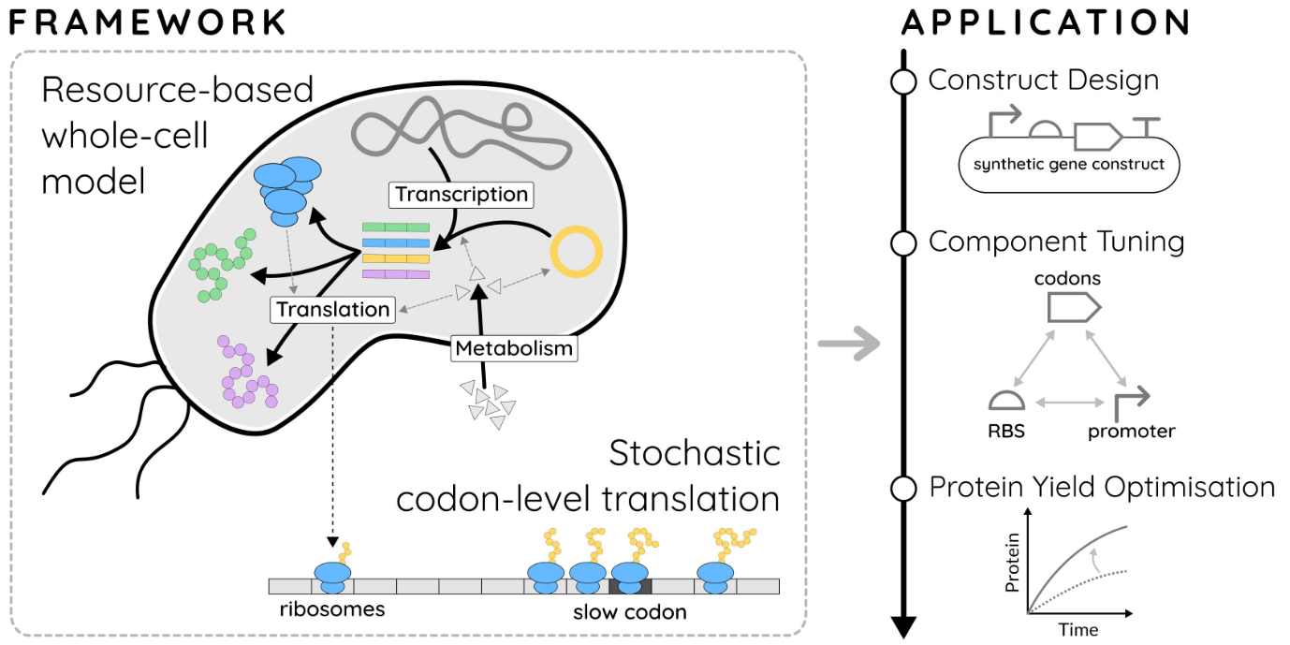
Notes:
The added-value of StoCellAtor lies in the detailed translation model compared to the model of Weisse, which uses a simple translation model without the consideration of polyribosomes or codons.
In StoCellAtor, we can show the effect of burden as well as slow codons, which exacerbates burden due to the ribosomes forming a queue on the heterologous mRNA.
We can use StoCellAtor to help in construct design, by, for example choosing a suitable RBS / promoter strength for a given synthetic gene and thereby optimizing the synthetic protein yield – we will show this later.

Slide 18
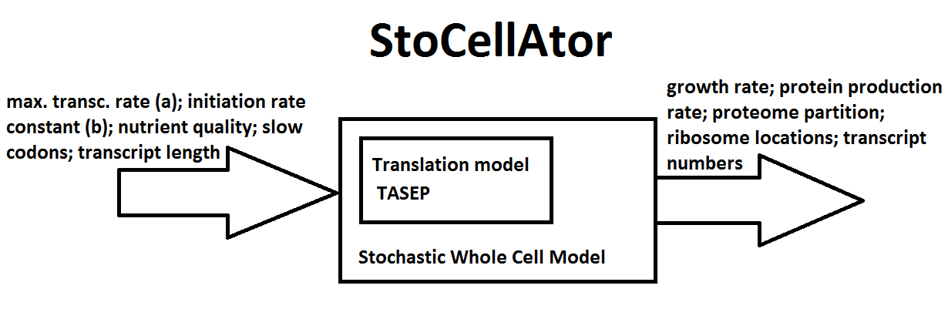
Model burden of heterologous transcript on cell
Notes:
We can thing of StoCellAtor as a black box taking in some inputs such as promoter/RBS strength, codon elongation rates, transcript length and nutrient quality.
The output may vary depending on the application, but we expect the most commonly used outputs to be the growth rate, heterologous production rate, number of heterologous proteins produced and ribosome density on the mRNA.

Slide 19
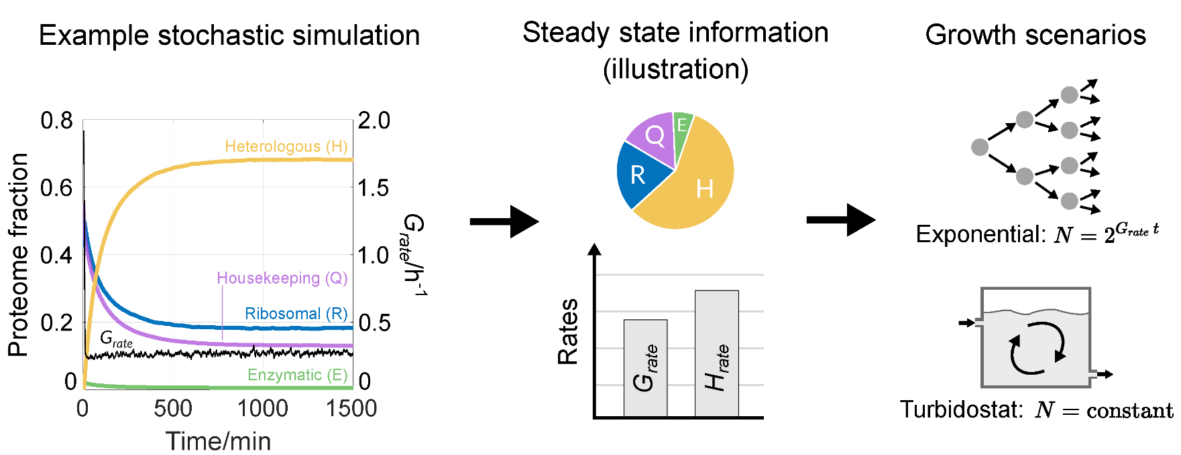
https://www.youtube.com/watch?v=EPMutCumilk&feature=youtu.be
Notes:
As a summary here are a few insights StoCellAtor can help us gain. We can peek inside the cell at any given time and we can examine the dynamics of synthetic protein production. We can also see how the proteome fractions change in time in the transient phase and how they stabilize once the model reaches steady-state.
To further illustrate, let’s watch a video where I plot some of the cell states against time.

Slide 20
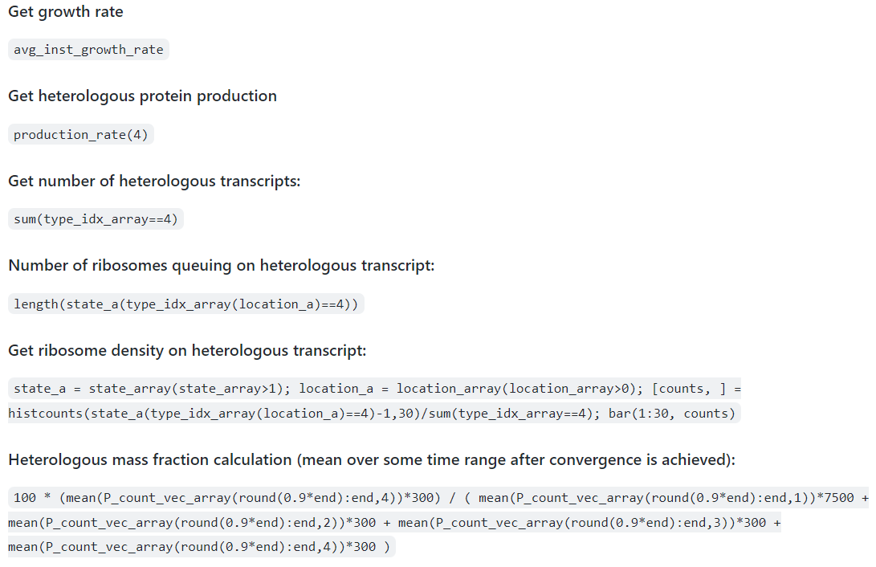
Simple applications
Notes:
Some simple applications follow – more are on the StoCellAtor GitHub page! You can download the simulation results from Zenodo and execute these pieces of codes in Matlab to get various outputs and nice graphs!

Slide 21
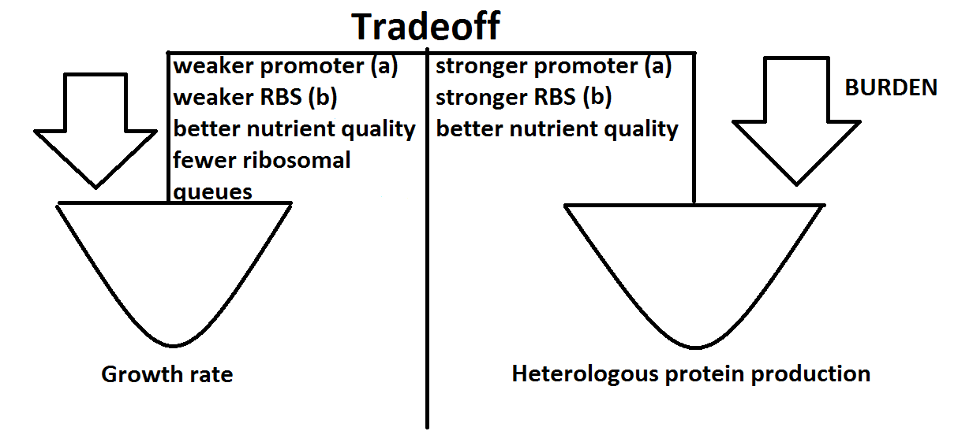
Factors affecting growth and production rate, Burden
Notes:
For optimizing synthetic protein yield, we must consider the tradeoff between growth rate and heterologous protein production rate. Stronger promoter on the synthetic gene and stronger RBS increase Heterologous Production Rate, but we expect, they would reduce the cell’s Growth Rate. We also expect more ribosomal queues to reduce growth rate since the ribosomes are sequestered on the heterologous transcript rather than translating transcripts that are necessary for the cell’s survival.
More about burden: Borkowski O, Ceroni F, Stan GB, Ellis T. Overloaded and stressed: whole-cell considerations for bacterial synthetic biology. Curr Opin Microbiol. 2016 Oct;33:123-130. doi: 10.1016/j.mib.2016.07.009. Epub 2016 Aug 2. PMID: 27494248.

Slide 22
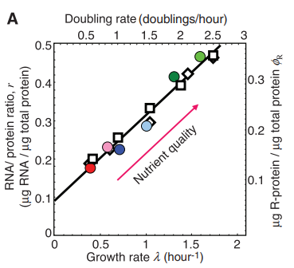
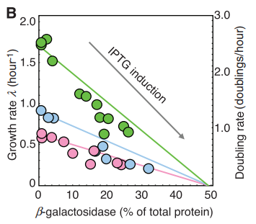
Model validation
From Scott M, Gunderson CW, Mateescu EM, Zhang Z, Hwa T. Interdependence of cell growth and gene expression: origins and consequences. Science. 2010 Nov 19;330(6007):1099-102. doi: 10.1126/science.1192588. PMID: 21097934
Notes:
We know that no model is perfect, but some are useful. We would like to show that not only does StoCellAtor can capture and explain behaviours related to burden and slow codons, but it is also coherent with well-known growth relationships observed in E.Coli. These graphs are from the famous paper by Scott et al and the left shows Schaechter’s law: the linear relationship between growth rate and RNA/protein ratio. The right one shows how growth rate declines linearly with the proteome fraction of the unnecessary protein produced by the cell. This is from Scott et al. so we will refer to this as Scott’s law. (The heterologous proteome fraction increases with IPTG induction of the T7 promoters. The different lines are for different strains grown on different medium.)
Scott M, Gunderson CW, Mateescu EM, Zhang Z, Hwa T. Interdependence of cell growth and gene expression: origins and consequences. Science. 2010 Nov 19;330(6007):1099-102. doi: 10.1126/science.1192588. PMID: 21097934.

Slide 23
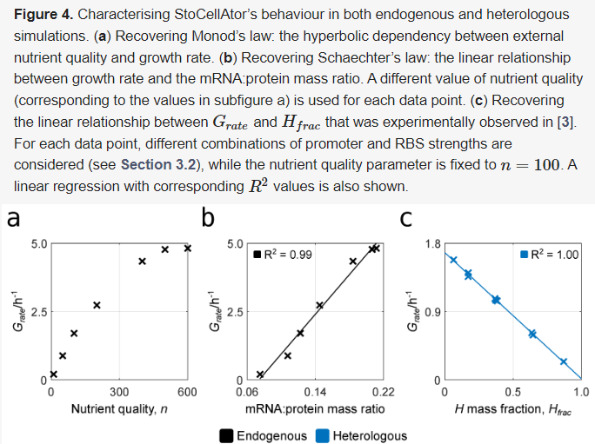
Notes:
Remarkably, StoCellAtor recovers these relationships without a sweat. On the left, we show Monod’s growth law, and the middle shows the reproduction of Schaechter’s law and the right one recovers the linear relationship between growth and unnecessary protein fraction (Scott’s law).

Slide 24
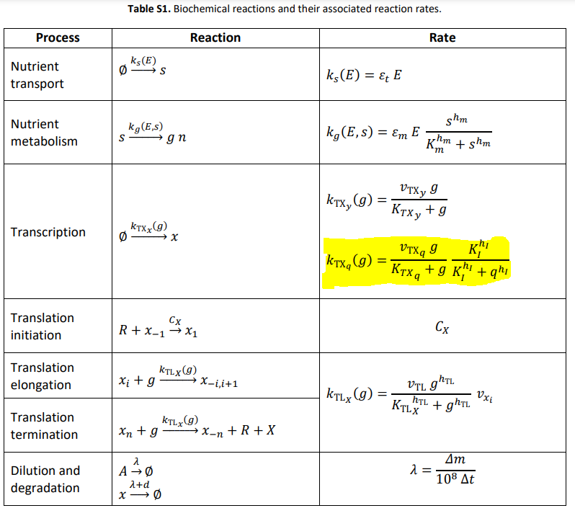
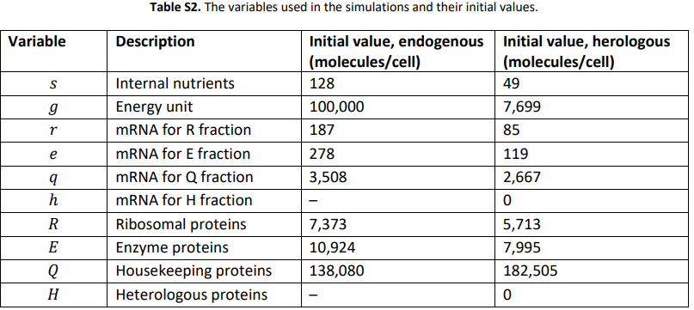
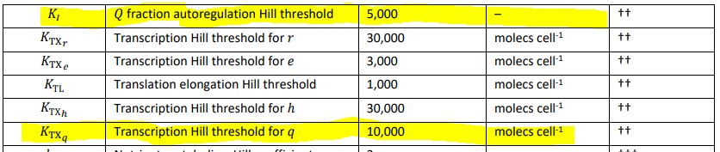
Methods
Notes:
Let’s talk a little bit about the methods. We’re essentially extending the TASEP methodology for processes other than translation. We define biochemical reaction rates, in most cases following the ones described in Weisse et al.
Let’s look at an example: transcription of the housekeeping mRNAs. We see first-order Hill kinetics with respect to the available energy (g), and negative autoregulation with Hill coefficient h_I: The more housekeeping transcripts we have, the slower transcription will be. The parameter values and variables can be looked up in the adjacent tables. This is taken from the Supplementary material of the original article.

Slide 25
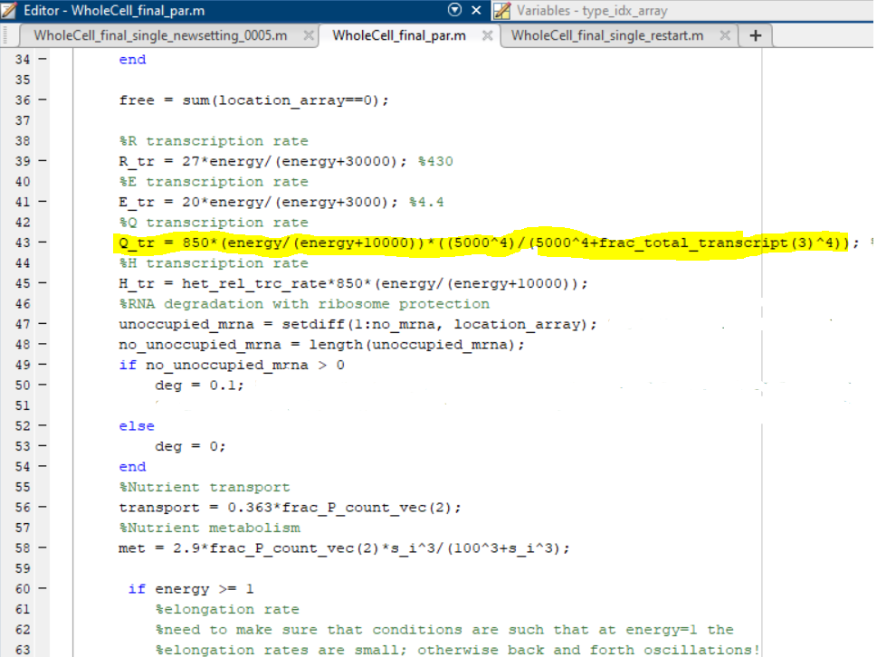
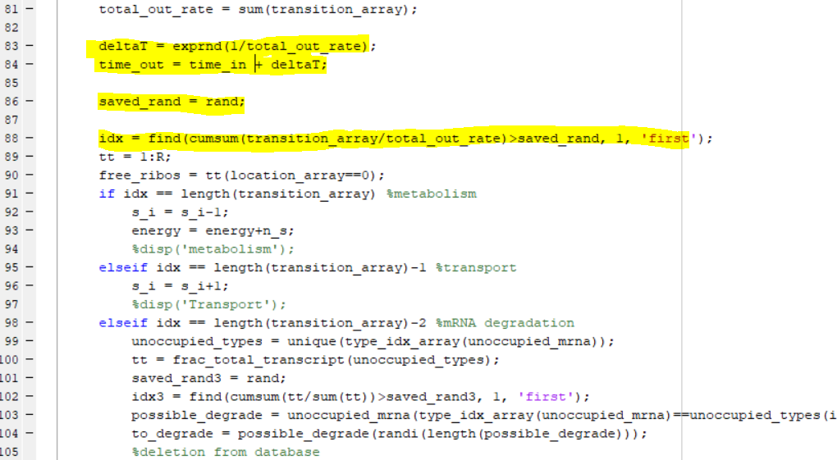
The code
Notes:
Let’s have a glimpse of how it’s coded up in Matlab. On the left you see the calculation of the transcription rate. On the right, we draw a time from exponential distribution and a random number to randomly (but proportionally to transition rates) select the next transition.

Slide 26
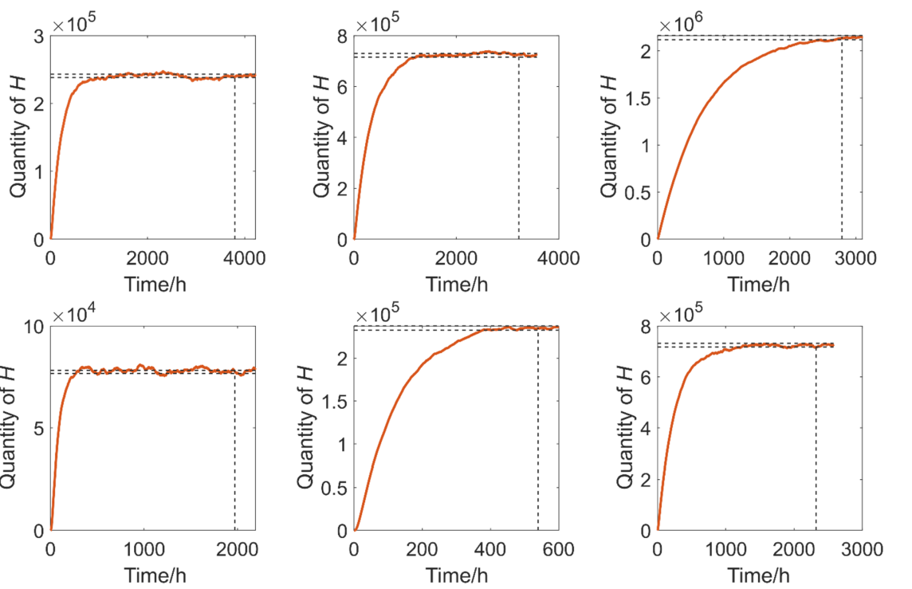
Convergence
Rule of thumb: shouldn’t deviate more than 1% from its mean in the last 10% of the simulation time
Notes:
We can think of our model as a Markov chain with changing transition probabilities. There are no obvious rules for convergences of such processes, in fact not even a guarantee of convergence. Hence, we check manually that each of our simulations have converged.

Slide 27
Results
RBS strength relative to that of innate mRNAs in the model
1/3, 1 or 3
‘Promoter strength’ (maximum transcription rate) relative to that of the innate housekeeping DNA
1/3, 1 or 3
Slow codons
None, slow codon at 5th or 26th position
Slow codon relative rate of 3% or 0.5%
Heterologous mRNA length of 30 (same as housekeeping, from Weisse et al.) or 60 ribosomal footprints
Notes:
We conducted simulations in the following design space… The values highlighted in red are corresponding to the conditions we used to get our main text results in the paper.

Slide 28
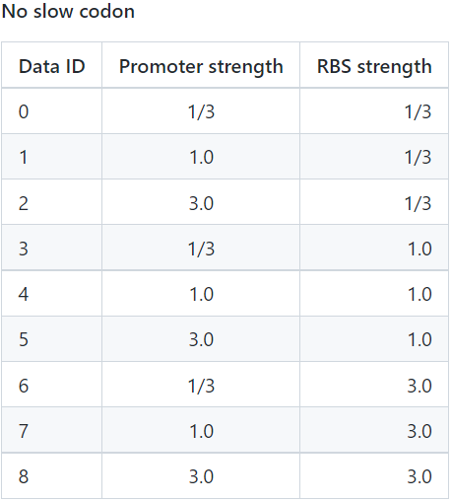
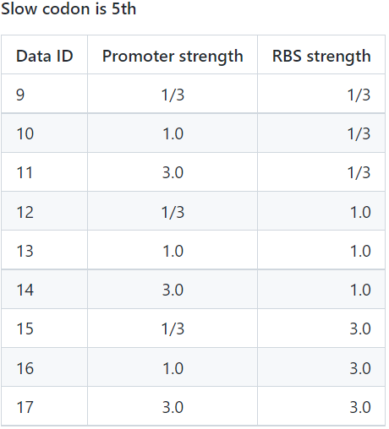
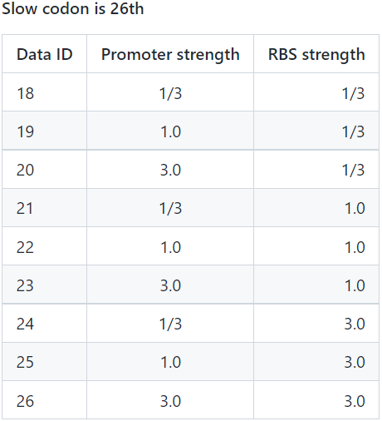
Notes:
This is the design space for the 27 simulations we ran to produce the results in the main text. Before we look at the main text results, let’s first take a peek at some very intuitive findings.

Slide 29
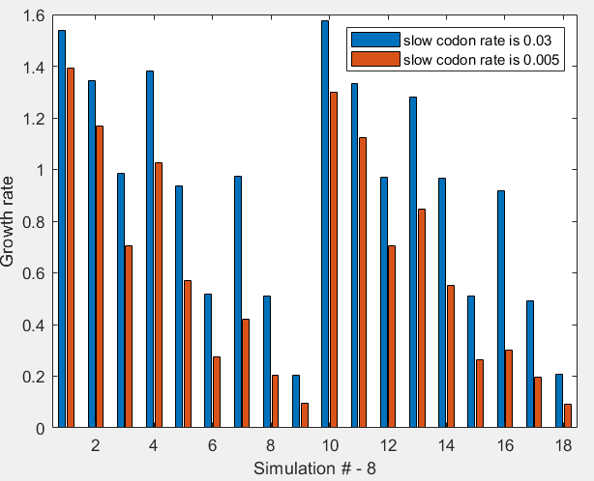
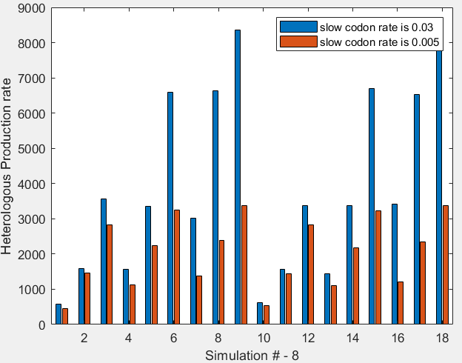
Plot showing 0.03 vs 0.005
Notes:
How does slowing down a codon affect growth rate and heterologous production rate?

Slide 30
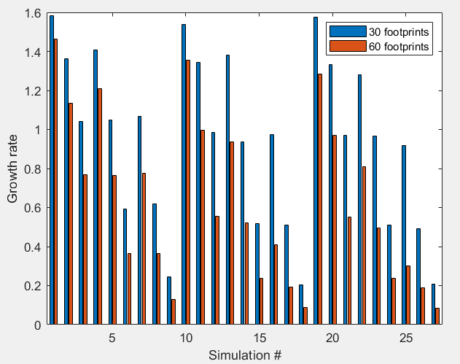
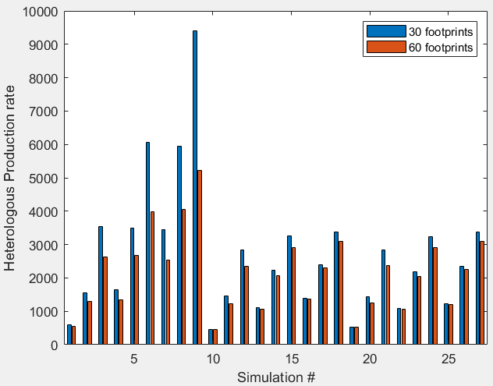
Longer protein takes more resources
Notes:
How does increasing heterologous transcript length affect growth rate and heterologous production rate?

Slide 31
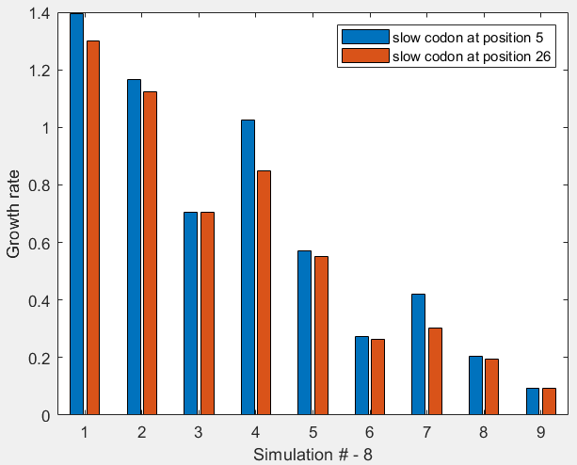
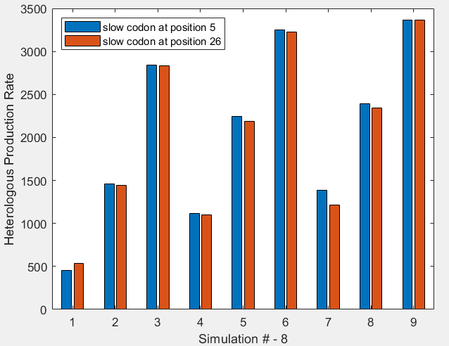
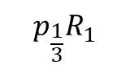
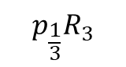
Slow codon towards 5’ vs 3’ end
$$p_{\frac{1}{3}}R_{1}$$
$$p_{\frac{1}{3}}R_{3}$$
Notes:
We see that for heterologous production rate there’s not much difference whether we put the slow codon toward the 5’ or the 3’ end.
It seems, however, that for growth rate, putting a slow codon towards the 5’ end can be advantageous. Especially in those cases highlighted in the graph, where we have low promoter strength, so relatively not many transcripts, but medium or high RBS so we’re ushering the limited ribosomes onto these heterologous transcripts. In such case, of course, we expect severe queueing and hence the reduced growth rate.

Slide 32
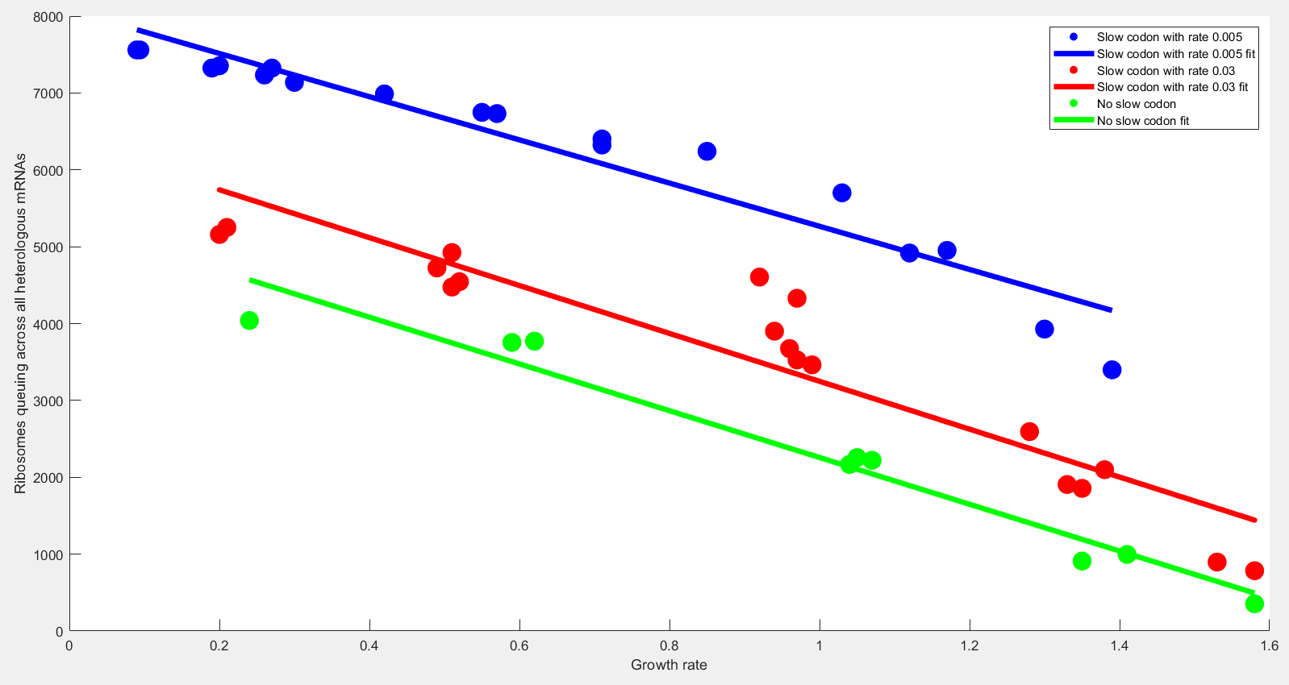
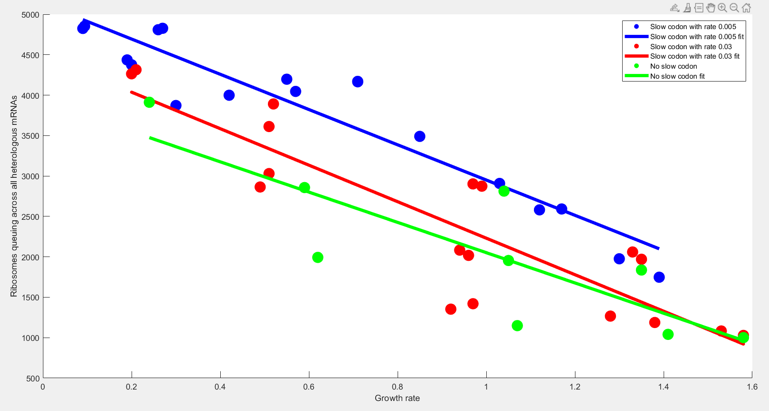
Ribosomes queuing vs. growth rate
Notes:
Finally, a graph that show indisputably, how important it is to take ribosomal queuing into account. And to take ribosomal queuing into account, you need a codon-level translation model. Note that here we’re not normalizing by the number of mRNAs the ribosomes are queuing on.

Slide 33
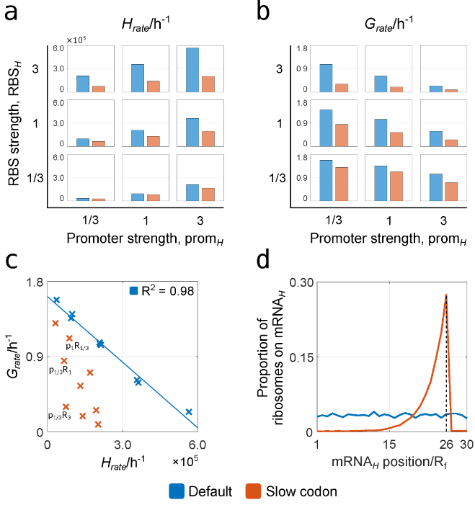
Notes:
This is some of our main text results. On the top left, you see that the H_rate increases with prom_H, the strength of the heterologous promoter and with RBH_H, the strength of the heterologous RBS. Then, top right, we see that the opposite is true for the growth rate. We already know the explanation – it is burden! Bottom left, we see that the linear relationship between growth rate and H_rate break down with slow codons – in fact, we see in the three highlighted cases that 3 constructs have the same H_rate, but dramatically different growth rate. This shows how important it is to optimize constructs. Imagine you end up with the bottom construct, it’ll take you a lot longer to get the same protein yield!
The bottom right plot shows the ribosome density at each ribosome footprint along the heterologous mRNA – we observe the effect of queuing on the 5’ end of slow codon.

Slide 34
What we learnt – Plots – Summary
Slow codon closer to the 3’ end is better (less queuing)
Slower codons seem worse than non-slow for growth rate (obviously worse for heterologous protein production rate)
For the same parameters, longer heterologous mRNA results in lower growth rate and lower heterologous production rate
Both increasing RBS and promoter strength seem to help heterologous protein production rate, but lower growth rate
Notes:
I already explained these, so will skip this for the interest of time.

Slide 35
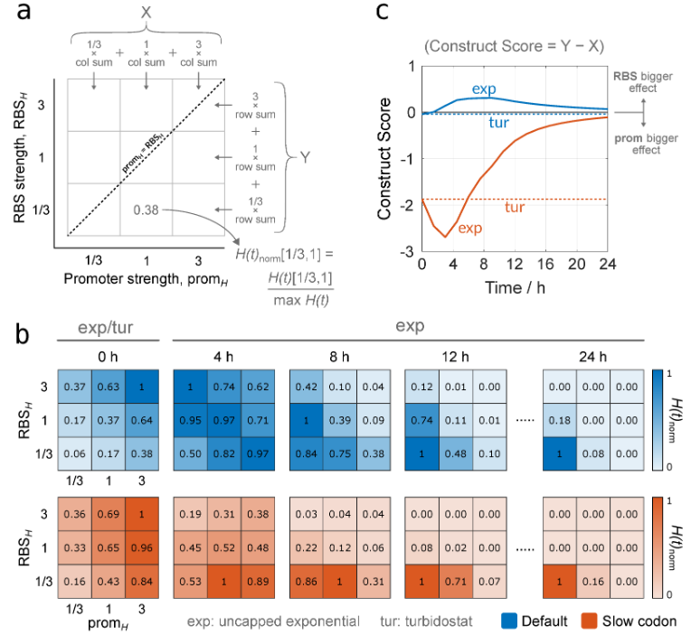
Notes:
Now let’s talk about heterologous protein yield and construct optimization. Let’s start by looking at the bottom part of the graph first. As the time progresses constructs with higher growth rate become better at producing higher protein yield – no wonder, we’re looking at exponential growth here, so with time, the number of existing cells is more and more important than the individual cell’s heterologous protein production rate in determining protein production yield. Hence the longer the time, the constructs with least burden will be more and more efficient.
On the top, we see an arbitrary metric, that gives the intuition whether promoter or RBS strength are more important in determining protein yield. The formula is on the graph, I leave a few seconds for everyone to look at it. The intuition behind the formula is the following: imagine that the yield values in the 3*3 square are symmetric along the dotted line. Then, of course, the RBS strength and protein strength are equally important. Now start thinking about putting higher values in one of the off-diagonal cells. If the promoter index is higher, then the formula will give you what you expect: that promoter is more important. We can plot these importance scores over time to get the graph on the top right.

Slide 36
Graph Explanation - Summary
Turbidostat case is easy; number of cells are kept in constant regardless of growth rate (unless it’s so slow that the cell basically dies or accumulates too many mutations), so number of proteins produced is just proportional to GR
In exponential growth case, depending on the time, lower RBS and promoter strength could be more optimal due to higher GR of the cell
In slow codon, increasing promoter strength increases protein production more than increasing RBS – this is because higher RBS leads to ribosomal queuing on the 3’ side of the slow codon

Slide 37
Future
StoCellAtor takes codon elongation rates, but where do we get those?
We could approximate the relative codon rates in model using the tRNA adaptation index (tAI)
tAI based on the number of different tRNAs available in the host cell with matching anticodon
Then, we could experimentally measure heterologous protein expression rate and conduct correlation studies between the obtained rates vs the model ones
Mutation accumulation in slow growth rate conditions (paper soon by Duncan Ingram)
Speedup:
running more simulations and using system identification / machine learning to quickly predict model outcome
Notes:
StoCellAtor takes codon elongation rates. So far, we assumed that these rates are the same, except for that of slow codons for which we chose arbitrary rates.
What we’d be really interested to do is picking a few commercially valuable proteins, inferring their codon elongation rates using the tRNA adaptation index and then correlate the heterologous protein production rate/yield in the model with the experimentally measured one.
If you’re not familiar with the tRNA adaptation index, it is based on the number of different tRNAs available in the host cell with matching anticodon and is described in dos Reis et al.
My co-author, Dunan Ingram is currently doing some exciting work on mutation accumulation in cases of slow growth rate, so stay tuned for that.
We’d also be interested in speeding up the simulations either by revision the code or by using system identification/ML tools to get a quick prediction for the model output.
dos Reis, M., Savva, R. & Wernisch, L. Solving the riddle of codon usage preferences: a test for translational selection. Nucl. Acids Res. 32, 5036–5044 (2004).

Slide 38
Acknowledgements
Thank you to my collaborators
Duncan Ingram
Prof. Guy-Bart Stan

Slide 39
References
Sarvari P, Ingram D, Stan G-B. A Modelling Framework Linking Resource-Based Stochastic Translation to the Optimal Design of Synthetic Constructs. Biology. 2021; 10(1):37. https://doi.org/10.3390/biology10010037
Weiße, A.Y.; Oyarzún, D.A.; Danos, V.; Swain, P.S. Mechanistic links between cellular trade-offs, gene expression, and growth. Proc. Natl. Acad. Sci. USA 2015, 112, E1038–E1047.
dos Reis, M., Savva, R. & Wernisch, L. Solving the riddle of codon usage preferences: a test for translational selection. Nucl. Acids Res. 32, 5036–5044 (2004)
Welch M, Govindarajan S, Ness JE, Villalobos A, Gurney A, Minshull J, et al. (2009) Design Parameters to Control Synthetic Gene Expression in Escherichia coli. PLoS ONE 4(9): e7002. https://doi.org/10.1371/journal.pone.0007002
Reuveni S, Meilijson I, Kupiec M, Ruppin E, Tuller T (2011) Genome-Scale Analysis of Translation Elongation with a Ribosome Flow Model. PLoS Comput Biol 7(9): e1002127. https://doi.org/10.1371/journal.pcbi.1002127
R. J. R. Algar, T. Ellis and G. . -B. Stan, "Modelling essential interactions between synthetic genes and their chassis cell," 53rd IEEE Conference on Decision and Control, 2014, pp. 5437-5444, doi: 10.1109/CDC.2014.7040239
Borkowski O, Ceroni F, Stan GB, Ellis T. Overloaded and stressed: whole-cell considerations for bacterial synthetic biology. Curr Opin Microbiol. 2016 Oct;33:123-130. doi: 10.1016/j.mib.2016.07.009. Epub 2016 Aug 2. PMID: 27494248
Scott M, Gunderson CW, Mateescu EM, Zhang Z, Hwa T. Interdependence of cell growth and gene expression: origins and consequences. Science. 2010 Nov 19;330(6007):1099-102. doi: 10.1126/science.1192588. PMID: 21097934

Slide 40
Additional results with multiple slow codons – Case study 1
Compare the following 2 scenarios
They both have
Heterologous mRNA length of 30 ribosomal footprints
A slow codon with relative speed of 0.5% on the 26th footprint
Relative promoter strength of 0.3 and relative RBS strength of 0.3
They differ
1) First has a slow codon at position 1 with relative speed of 0.005
2) Second has a slow codon at position 5 with relative speed of 0.005
Notes:
We compare two double slow codon cases. One with the second slow codon at position 1 and one at position 5.

Slide 41
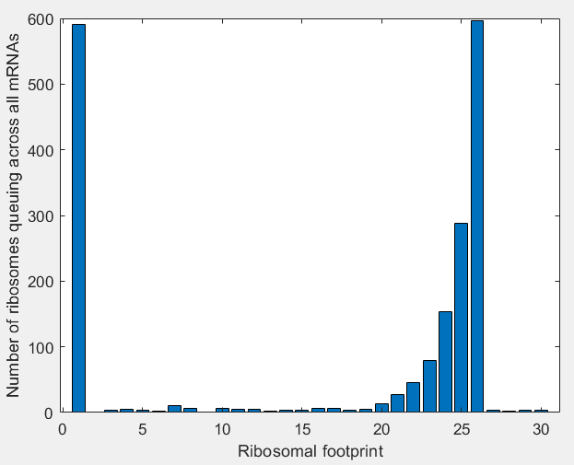
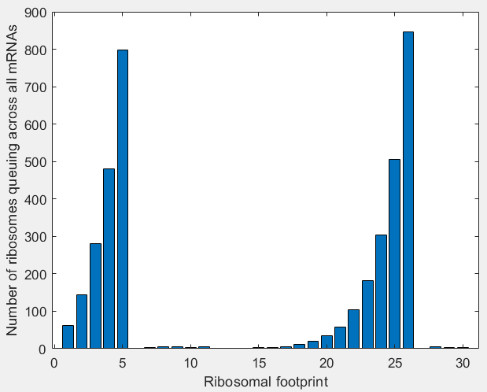
Second slow codon at position 1 vs position 5
GR= 1.60; HR=202; 1085 mRNAs; 1883 ribosomes on mRNA
GR=1.37; HR=440; 1302 mRNAs; 3877 ribosomes on mRNA
Notes:
We see that putting a slow codon at the very beginning increased the growth rate and reduced the number of ribosomes queuing.

Slide 42
Additional results with multiple slow codons – Case study 1
Compare the following 3 scenarios
All have
Heterologous mRNA length of 30 ribosomal footprints
A slow codon with relative speed of 0.5% on the 26th footprint
Relative promoter strength of 0.3 and relative RBS strength of 0.3
They differ
1) One has no other slow codons
2) One has a slow codon at position 5 with relative speed of 0.005
3) One has a slow codon at position 1 with relative speed of 0.005
Notes:
We compare the only one slow codon case with two double slow codon cases. One with the second slow codon at position 1 and one at position 5.

Slide 43
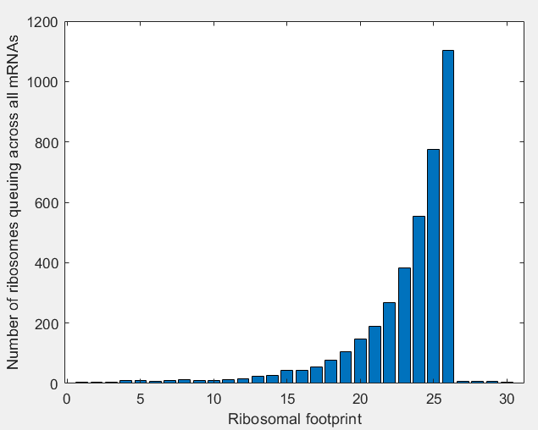
Only one slow codon vs. second slow codon
GR= 1.3; HR=533; 1495 mRNAs; 1976 ribosomes on mRNA
GR=1.37; HR=440; 1302 mRNAs; 3877 ribosomes on mRNA

Slide 44
Additional results with multiple slow codons – Case study 2
Compare the following 3 scenarios
All have
Heterologous mRNA length of 30 ribosomal footprints
A slow codon with relative speed of 0.5% on the 26th footprint
Relative promoter strength of 0.3
They differ
1) One has no other slow codon and relative RBS rate of 0.3
2) One has a slow codon at position 1 with relative speed of 0.1 and relative RBS rate of 3
3) One has no other slow codon and RBS rate of 3
Notes:
Here we look at the case when we have 2 slow codons, and the first slow codon is right at the first ribosomal footprint with relative rate of 0.1. We compare it with the case with no slow codon on the first ribosomal footprint and to the case of a 10 times lower RBS strength.

Slide 45
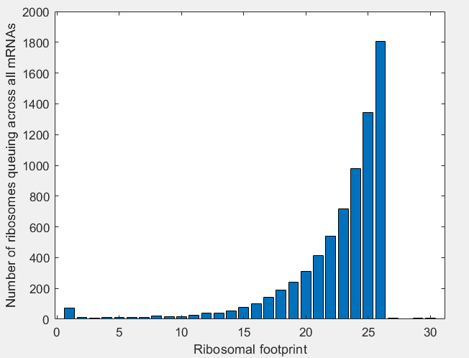

Slow codon at beginning vs lower RBS
GR= 0.333; HR=1130; 2393 mRNAs; 3795 ribosomes on mRNA
GR=1.30; HR=532.6; 1495 mRNAs; 1976 ribosomes on mRNA

Slide 46
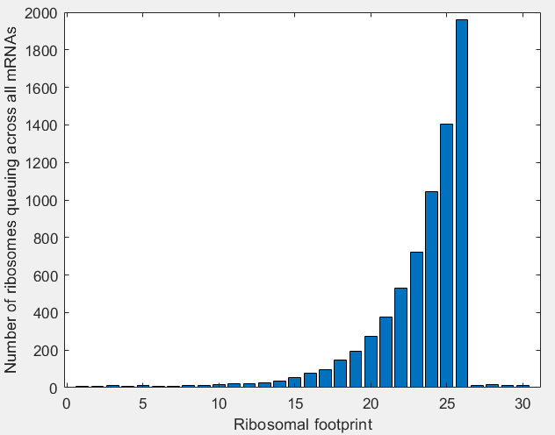
Slow codon at beginning vs not
GR= 0.333; HR=1130; 2393 mRNAs; 3795 ribosomes on mRNA
GR=0.302; HR=1217; 2760 mRNAs; 3872 ribosomes on mRNA
Notes:
In the end, the slow codon at the beginning didn’t make much difference compared to no slow codon there – the rate wasn’t that low and it didn’t act like a lower RBS. Presumably because the ribosome binding also depends on the number of free ribosomes.

Slide 47
Additional results with multiple slow codons – Case study 3
Compare the following 3 scenarios
All have
Heterologous mRNA length of 30 ribosomal footprints
A slow codon with relative speed of 0.5% on the 26th footprint
Relative promoter strength of 1
They differ
1) One has no other slow codon and relative RBS rate of 0.3
2) One has a slow codon at position 1 with relative speed of 0.1 and relative RBS rate of 3
3) One has no other slow codon and RBS rate of 3
Notes:
Here we do the same experiment, but now the promoter strength is 1. We essentially obtain the same conclusion.

Slide 48
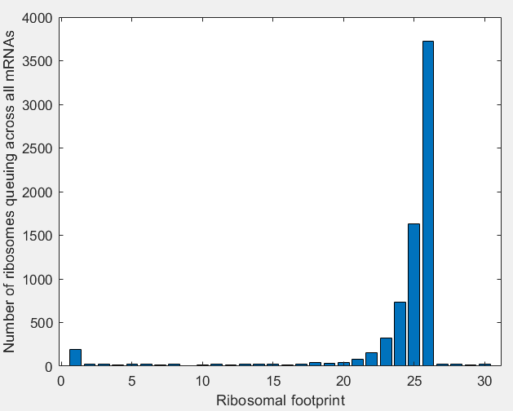
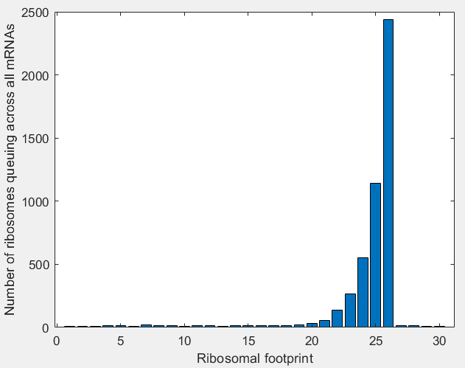
Slow codon at beginning vs lower RBS
GR= 0.196; HR=2341; 8274 mRNAs; 7335 ribosomes on mRNA
GR=1.12; HR=1447; 5323 mRNAs; 4918 ribosomes on mRNA

Slide 49
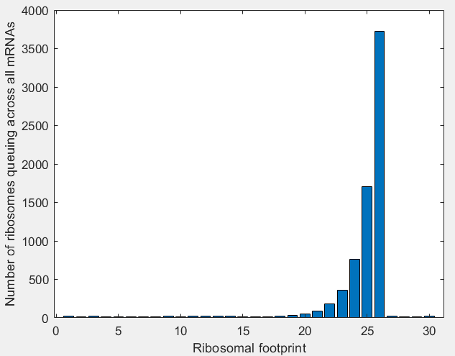
Slow codon at beginning vs not
GR= 0.196; HR=2341; 8274 mRNAs; 7335 ribosomes on mRNA
GR=0.194; HR=2341; 8295 mRNAs; 7324 ribosomes on mRNA

Slide 50
tAI
From Zur H, Cohen-Kupiec R, Vinokour S, Tuller T. Algorithms for ribosome traffic engineering and their potential in improving host cells' titer and growth rate. Sci Rep. 2020 Dec 3;10(1):21202. doi: 10.1038/s41598-020-78260-y. PMID: 33273552; PMCID: PMC7713304.
Sij – selective constraint that the jth tRNA recognizes ith codon (0-1, 1 is more selective)
Wi is the absolute adaptiveness for each codon

Slide 51
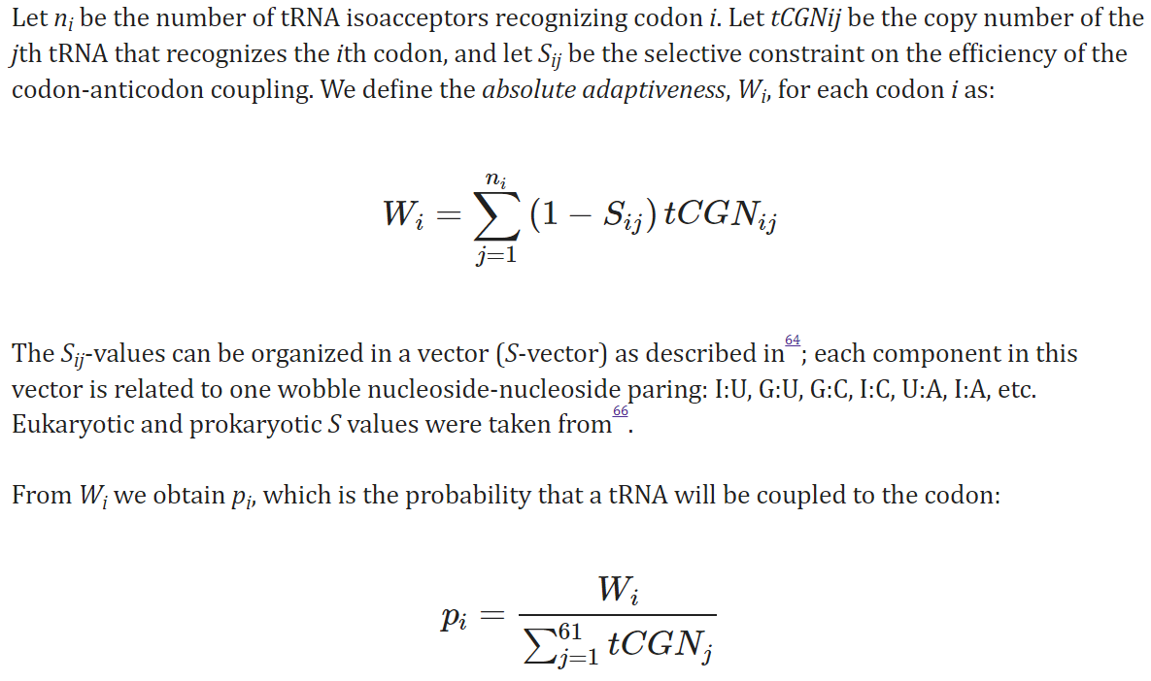

Slide 52
